Slide 1
WELCOME
Presentation Topic: Postorder Traversal of Binary Tree
MD. MASUD RANA
ID: 2211176104
Course: Data Structure
Computer Science and Engineering

Slide 2
What we will learn from this?
What is Binary Search Tree?
What is Traversing?
What Post Order Traversing?
Posr order traversing Algorithm
Algorithm flow
Complex analysis
Application

Slide 3
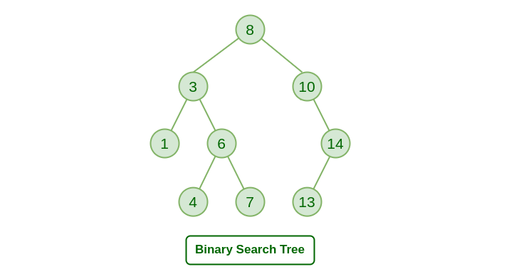
Binary Search Tree
Binary Search Tree is a data structure used in computer science for organizing and storing data in a sorted manner. Binary search tree follows all properties of binary tree and its left child contains values less than the parent node and the right child contains values greater than the parent node.

Slide 4
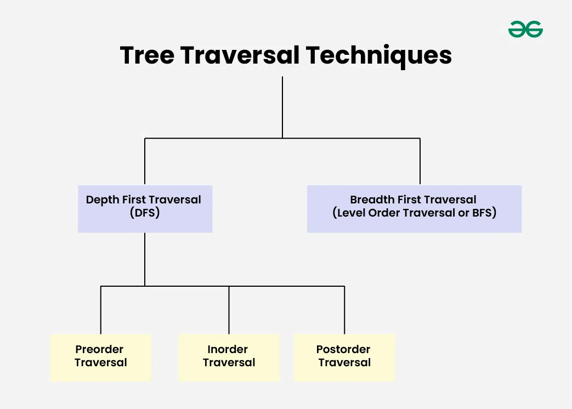
What is traversing?
Traversing a binary tree means visiting each node in the tree and processing its data.
There are three main traversal techniques: in-order, pre-order, and post-order traversal.
These traversal methods visit the nodes in a specific order, which can be useful in different applications.

Slide 5
Postorder Traversal
Postorder traversal is defined as a type of tree traversal which follows the Left-Right-Root policy such that for each node:
The left subtree is traversed first
Then the right subtree is traversed
Finally, the root node of the subtree is traversed

Slide 6
Algorithm for Postorder Traversal of Binary Tree:
The algorithm for postorder traversal is shown as follows:
Follow step 2 to 4 until root != NULL
Postorder (root -> left)
Postorder (root -> right)
Write root -> data
End loop

Slide 7
Algorithm
Initialize two stacks and an array.
Check if the root element is null. If it is null, then the tree is empty and returns an empty array.
Otherwise, push the root element to stack 1.
While stack 1 is not empty:
Remove the top element from stack 1.
Push that element to stack 2.
Check if the stack has left and right elements present. If present, push them onto stack 1, first pushing the left child and then the right child.
If stack 1 becomes empty, the while loop will end.
Now pop all elements from stack 2 and add them into the array.
The array list will contain the elements traversed in a post-order fashion.
Return the array.

Slide 8
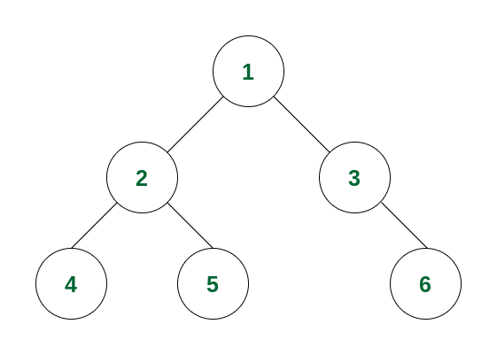
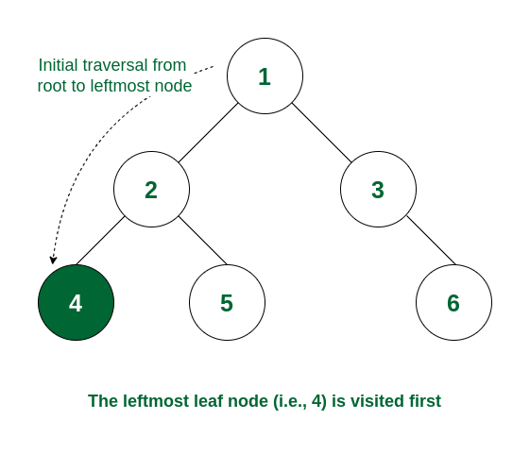
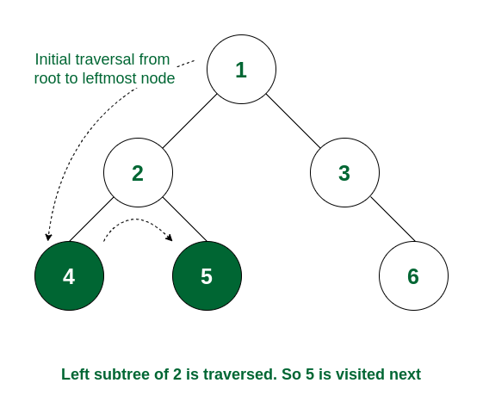
Flow of Algorithm

Slide 9
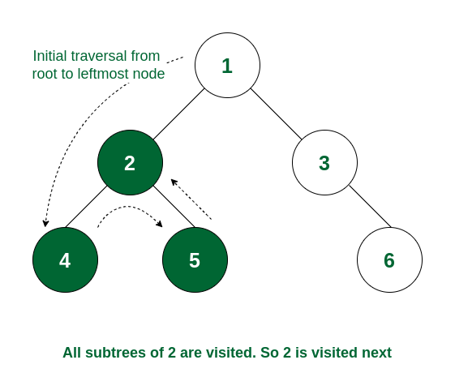
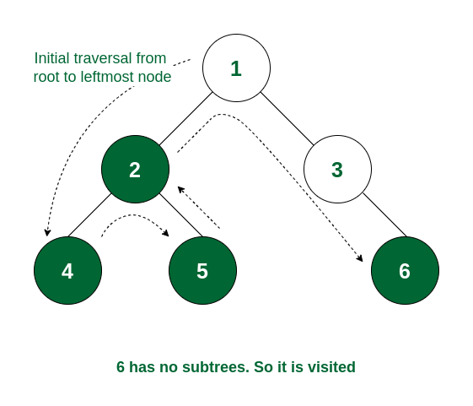
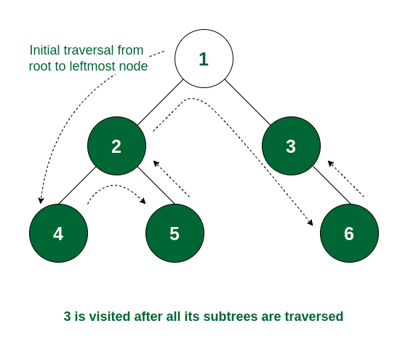
Flow of Algorithm

Slide 10
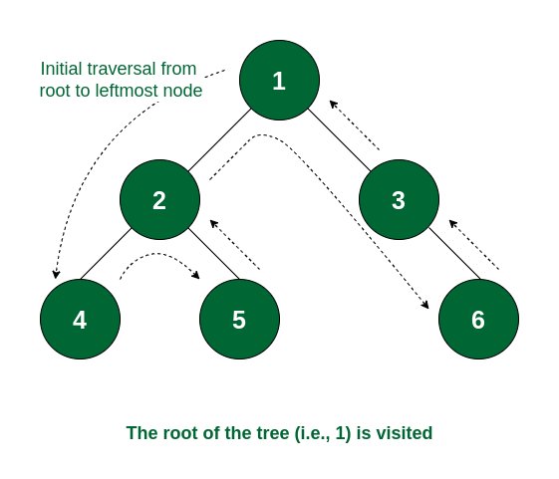
Final Result
So the order of traversal of nodes is 4 -> 5 -> 2 -> 6 -> 3 -> 1.

Slide 11
Complexity Analysis:
Time Complexity: O(N) where N is the total number of nodes. Because it traverses all the nodes at least once.
Auxiliary Space: O(1) if no recursion stack space is considered. Otherwise, O(h) where h is the height of the tree
In the worst case, h can be the same as N (when the tree is a skewed tree)
In the best case, h can be the same as logN (when the tree is a complete tree)

Slide 12
Use cases of Postorder Traversal:
This is used for tree deletion.
It is also useful to get the postfix expression from an expression tree.

Slide 13
Thank You

